Slide 1
FER Ensemble Is All You Need
Combining ViT and CNN Models for Mixed-Emotion Recognition
Team Alchemists - Kaifeng Lu, Ke Hu

Slide 2
Introduction: Facial Expression Recognition
Task:
Identify and classify mixed-emotions by analyzing facial expressions
Extraction of landmark facial features that correlates to each facial expression
Problem:
Most of models are not generalizable due to limited training dataset and overfitting
Mixed-emotion expression recognition is rarely studied
Vision transformer are not widely used and trained in this field with FER+.
Our work:
Reimplement FER-PCVT, FER-VT, Residual Masking Network, and ResNet
Ensemble the models by modifying template and weighted averaging for mixed emotion.
Extensive experiments on FER task

Slide 3
Related Work: VIT & CNN
Model Ensembling
Combine multiple neural network models to enhance predictive performance and achieve more robust results. By averaging weights and fusing results, we expect the ensemble to mitigate overfitting and leverage the diversity of learned patterns from each model, leading to improved generalization across datasets.
VIT
Transformer architecture that processes the entire image as patches and captures spatial information crucial for expressions.
It is excellent at handling global dependencies and variations in facial expressions, but requires a large amount of data for effective training.
CNN
Convolutional Neural Network extracts local features using convolutional layers and captures fine details like wrinkles, mouth curves, or eye movements.
It is robust in extracting local features, but it’s possible to struggle with global context and dependencies across facial regions, resulting lower accuracy.

Slide 4
Related Work: Models
Patch-Convolutional Vision Transformer:
The FER-PCVT model combines the local feature extraction capabilities of Convolutional Neural Networks with the global modeling strengths of Vision Transformers to create a lightweight framework for facial expression recognition.
FER-VT
FER framework contains two attention mechanisms that overcome the weakness of CNN-based models in learning long-range inductive biases for enhancing the performance of performing a FER task augmented with grid-wise attention mechanism.
Residual Masking Network
The Residual Masking Network integrates a ResNet backbone with Masking Blocks based on a U-net structure. It uses a segmentation network to refine feature maps, enabling the network to focus on relevant information to make correct decisions.
ResNet
The Residual neural network uses skip connections to allow the output of a layer to bypass one or more subsequent layers, thereby enabling the network to learn residual functions relative to the input.

Slide 5
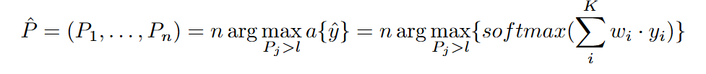
Methodology : Mixed Emotion Expression Ensemble
Weighted averaging ensemble
In our method, unweighted come y_i of K base learner i sums up by multiplying each to assigned weight w_i.
This weighted sum is normalized through common softmax program, yielding the consensus, where the weights are exactly the accuracy of each individual model.
Mixed-Emotion Expression Extraction
The output of n’s predicted expression P_hat is picked from the nmax labels of expression from y_hat if P_i surpasses certain limit l.

Slide 6
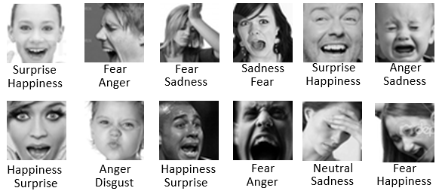
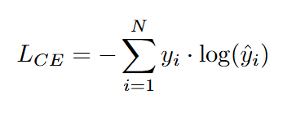
Experiment Setup
Dataset:
FERPlus, annotated with mixed-emotion scores for each class.
Training set contains 28,709 images and tested with 3,589 images cases
Resize images to 224x224 to match model input requirements.
Objective:
Cross Entropy Loss
Baseline:
ResNet-34, ViT-base, Residual Masking Network

Slide 7
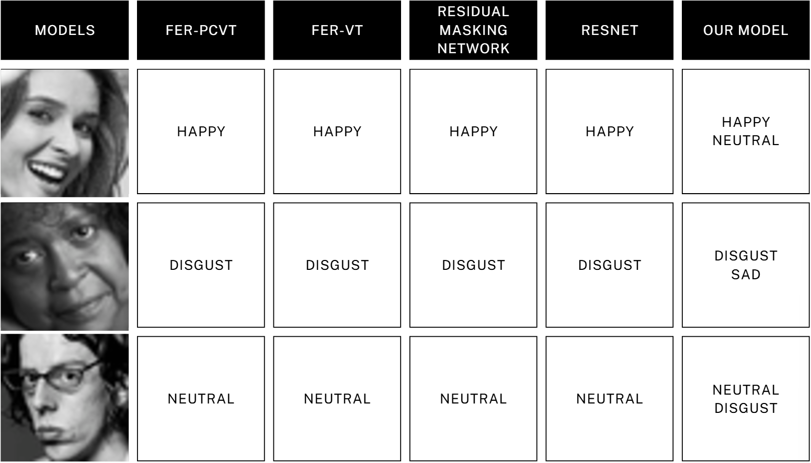
Qualitative Results

Slide 8
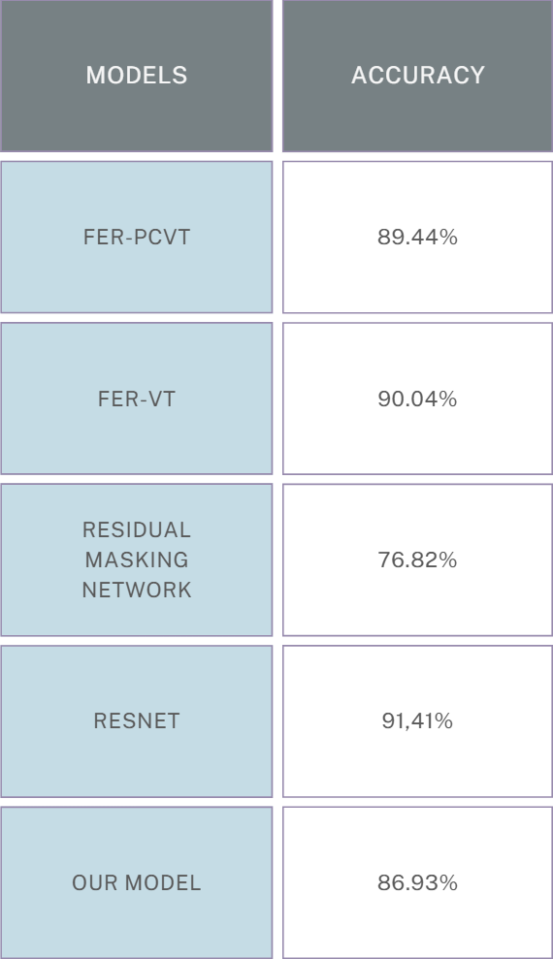
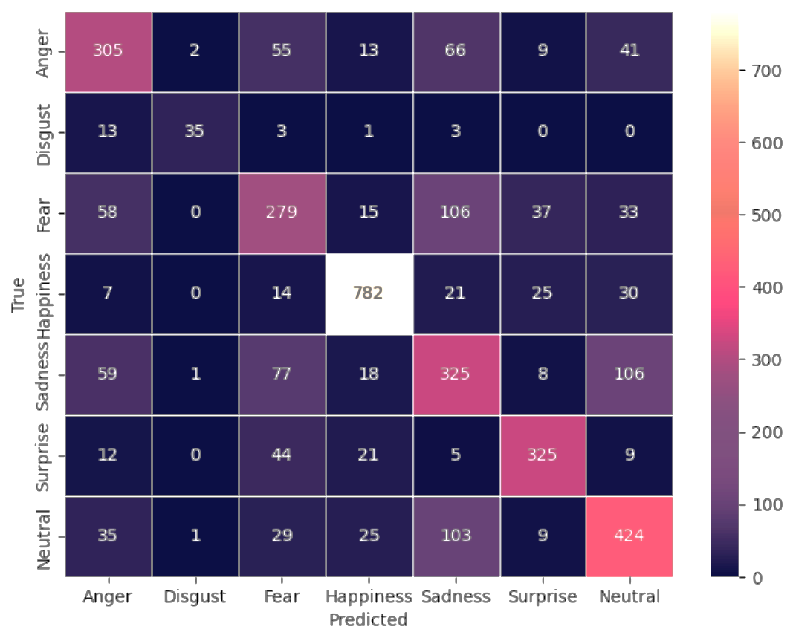
Quantitative Results

Slide 9
Conclusion
Summary of Objectives and Approach:
Developed an ensemble framework for mixed-emotion recognition using ViT and CNN models on the FERPlus dataset.
Adapted model outputs to identify top-2 emotions per input with predictions using weighted averaging for robust results.
Key Results:
Achieved improved top-2 accuracy and better generalization compared to individual models.
Successfully recognized subtle mixed emotions, validating the ensemble's effectiveness.
Future Directions:
Extend to model soup by assigning weights to hyperparameters for better adaptability.
Explore deeper hybridization of model architectures for enhanced ensemble performance.

